Slide 1
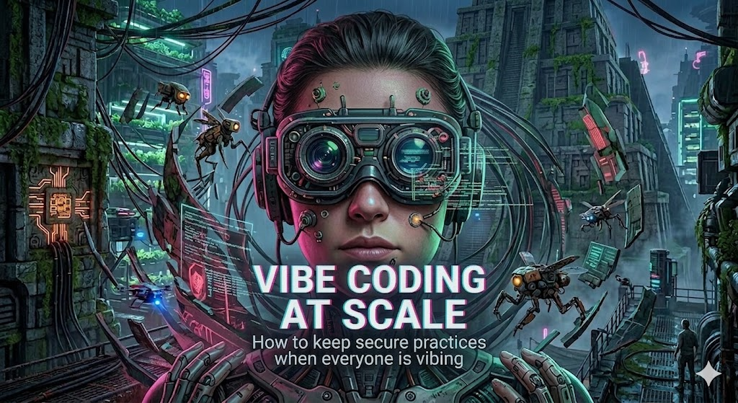

Slide 2


Nathaniel Engelsen, CISSP, MBA
SVP Technology, Augeo
Clea Ostendorf, CISSP
CEO/CoFounder Wolfpack Security

Slide 3
What is vibe coding?
"Vibe coding"—the practice of rapidly developing software through natural language prompts and AI agents without manually writing or reviewing most of the code—introduces a unique set of security risks. Because the focus is on "making it work" rather than rigorous engineering, security is often bypassed entirely

Slide 4
Where the Risk lies - 3 Risk Pillars
Critical Vulnerabilities - Immediate, exploitable holes
Tech Debt - The long-term "maintenance tax" of unoptimized, bloated, or "black box" logic.
Governance/Compliance - The erosion of traceability and the "Right to Explain."

Slide 5
Questions to ask your team
Build Ft. Knox: Make sure your app is safe and secure and avoid the Happy Path Trap
Are we making authorization decisions in the right policy decision point, or did we leave too much up to the client?
Is our authorization logic 'Decentralized AI-Gen' or 'Policy-as-Code'? If we changed a user role today, how many lines of code would we have to manually audit?
How do we programmatically ensure that data ownership is validated for every single object request, and do we have automated tests that attempt 'ID swapping'?

Slide 6
Questions to ask your team
Implement "Secret Scanning": Most platforms have tools that scan code for secrets before they get published.
"Do we have a secret scanner? (e.g., TruffleHog or GitHub Secret Scanning)"
"When was the last time we 'rotated' our master keys?"
"If a developer puts a password in an AI prompt, where does that password go?" (The answer is often: into the code).

Slide 7
The "70/20/10" Budgeting Model
70% of time on new features
20% on "Paying the Debt" (Refactoring)
10% on Innovation/Training.

Slide 8



Company | Guardrail | Business Lesson
 | Standardized Parts | Limit the AI’s "creativity" to pre-approved blocks.
 | Rigorous Review | Measure "Code Quality" as strictly as "Delivery Speed."
 | The Paved Road | Automate the "Security & Debt" checks so they can't be skipped.

Slide 9
The Tools (Smoke Detectors)
Tool type | What it does | Why it matters for Vibe Coding
Static Analysis Tools (e.g., SonarQube) | Scans for "smelly" or messy code. | AI is great at making code that works but stinks. This catches the smell.
Dependency Scanners (e.g., Snyk) | Checks if our libraries are old or broken. | Catches "hallucinated" / poisoned packages. AKA secures our “software supply chain”.
Complexity Metrics | Measures how "tangled" the logic is. | If a piece of code is too tangled for a human to understand, how can we ensure it has integrity?

Slide 10
Questions to ask your team
Maintenance Sprints: Intentionally pay down Tech Debt with focused effort and investment.
"How do we know if technical debt is getting worse?”
“Who is responsible for reviewing AI code and/or approving AI-created code to go to production?”
“How are we catching the smells / easy things?”

Slide 11
Questions to ask your team
Human In The Loop: Make sure you know who did what - and why.
Who owns this code, why did we create it, and how did it get into production?
Can we tell why we made this decision and is it defensible? Are we in breach of any legal obligations with the way we made a decision?
Have the packages and libraries in this code been vetted by a risk process or an architect?

Slide 12
Control Area | Requirement | Vibe Coding Risk | The "Fix"
Change Mgmt | Documented approvals for all code. | "Ghost Approvals" - AI writes, no one reads. | Human Peer Review for all AI code.
Data Privacy | No PII in AI training sets. | "Context Leaks" - Pasting data into prompts. | Enterprise-grade AI with "Zero-Retention" data privacy.
IP Protection | No unlicensed code in our product. | "Copyright Contamination" - AI copies GPL code. | Automated License Scanning on every build.

Slide 13
Vibe Security - Requirements & Planning
Prompt for Success - Built sophisticated prompts with coding standards and security requirements informed by open source projects
Add Vinters* to Agents - Add quality and security sub-agents to agent teams checking for smells
Skills to Pay the Bills - Incorporate skills from our vibe coding tool’s marketplace or open source projects
* vibe + linter = “vinter” (Nathaniel wants this to be popular, tell your friends)

Slide 14
Vibe Security - Deployment & Operations
Stop the Leak: Deploy DevSecOps tooling, including secrets, SAST, 3rd party dependencies, “code smells", and licensing, Also could be others too, like DAST.
Appoint a "Pilot": No AI code goes live without a human "Pilot-in-Command" who can explain the logic to an auditor.
Audit the Shadow: Run a discovery scan of your internal network to see how many "Vibe Apps" your departments have built without your knowledge.

Slide 15
Prepare:
Make a design doc (with AI!).
Use techniques like agent.md and modelfile to specify standards, like “write code like a senior security engineer”.
Ensure simple and clear security instructions are included in prompts and setup files.
If saving $: use expensive, thoughtful models to build plans, use cheaper models to create code.
Have a different model review output than the one that wrote it (Adversarial prompting).
Ensure a <person/pilot/architect> compare intended logic to actually implemented code.
Control:
Implement DevSecOps - it’s more important than ever.
Ensure you implement automated log collection and metric gathering and have AI build correlations.
Intentionally pay down AI-created technical debt.
Scan and version SBOMs. Look for unexpected changes, critical vulnerabilities, and compromised packages.
Figure out AI learning and improvement mechanisms based on performance and feedback.
Notes:
sources

